Slide 1
Stock Valuation
Meaning and key features of common stock
Common stock valuation:
Single and multiple holding periods,
The dividend discount model:
zero growth model,
normal growth model,
non-constant growth model,
valuing the entire firm
Preferred stock:
Features and valuation.

Slide 2
Common Stocks
Represent ownership position in a company and have residual claim on income and assets.
Entitled to receive dividends
Two basic functions:
Sources of financing and collateral for debt capital
Major source of financing Fixed assets

Slide 3
Features of Common Stocks
Par Value
Maturity
Claim on income
Claim on assets
Right to control
Voting rights
Proxy rights
Pre-emptive right
Limited liability

Slide 4
Valuation of common stock
Dividend discount model
a) Zero growth DDM
If growth in dividend is by zero percentage is called zero growth. This model assumed that dividend will be constant overtime. i.e.
D₀ = D₁ = D₂ = D_{n}
Value of stock can be calculate by following equation
P₀ =
Where, P₀ = Intrinsic (true) value of common stock
D = Dividend per share
k = require rate of return

Slide 5
Example 1
The dividend of ABC Company is estimated to be Rs. 8 per share indefinitely. What is current value of share if an investor requires a 10% rate of return on his investment?
P₀ =

Slide 6
b) Constant or Normal growth DDM
The constant growth model assumed that dividend will grow at constant rate. The stock with a constant dividend growth is actually a growing perpetuity.
Let g be a constant rate which dividend grows forever. Therefore, dividends are computed as:

Slide 7

Constant or Normal growth DDM
When we substitute them in Equation, the current price of the stock is obtained as
Assume that g is smaller than r_{e}. In this case the general formula becomes

Slide 8
Example 2
Fast Food Manufacturing Company’s dividend is expected to grow at the rate or 10% per annum. The last year dividend of Fast Food Manufacturing Company was Rs. 3 per share. What price will you pay for it if your required rate of return for this equity is 15%?
D₁ = D₀ (1+g) = 3 (1+0.10) = Rs. 3.3
=

Slide 9


C) Multiple growth model
The dividend of company may not grow at constant rate. Future growth rate might shift up or down. In this case, we need to extend the constant dividend growth model and define sub-periods with different growth rates. Then we can estimate the value of stock by considering each sub period with their discounting.
Find present value, PV(NCD), of non-constant growth dividends, D_{k}(NC) at each sub periods 1 ≤ t ≤ n as
Find present value of constant growth dividends PV(P_{t} ) where

Slide 10

C) Multiple growth model
Then the present value of the stock is basically sum of present values of all dividends as
If a stock has non-constant growth in dividend up to three years and constant rate of growth then after, Price of the sock can be determined as:

Slide 11
Example 3
The next three years dividends for Company Y are expected to be £0.50, £1.00, £1.50. Then the dividends are expected to grow at a constant 5% forever. If the required return is 10%, then what is the value of the stock?
For the non-constant dividend growth

Slide 12
For the constant dividend growth based on third year dividend D₃
The current price of the stock is the present value of the stock

Slide 13
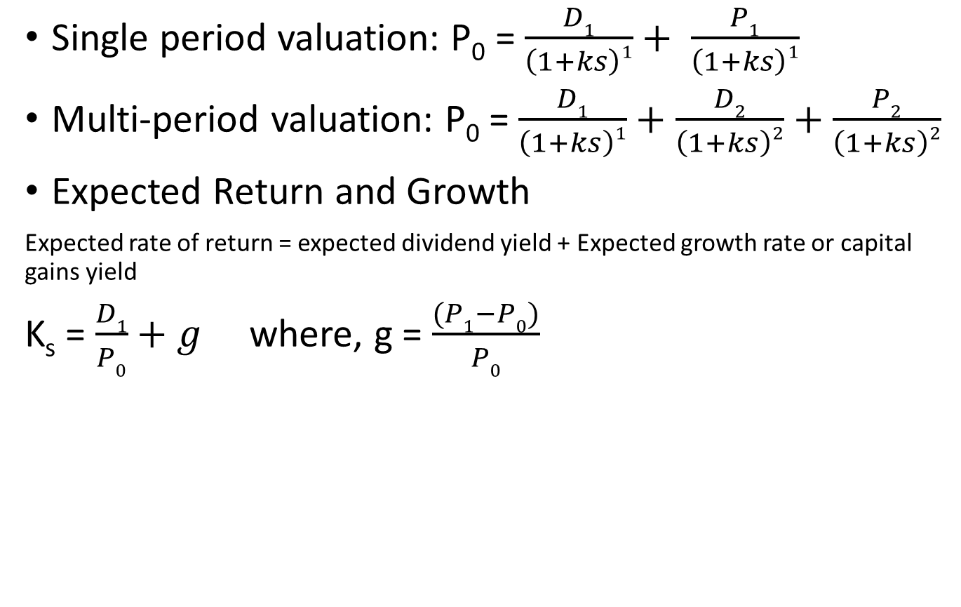
Single Period Valuation and Multi-period Valuation
Single period valuation: P₀ = $\frac{D1}{\left(1+ks\right)1}+ \frac{P1}{\left(1+ks\right)1}$
Multi-period valuation: P₀ = $\frac{D1}{\left(1+ks\right)1}+\frac{D2}{\left(1+ks\right)2}+\frac{P2}{\left(1+ks\right)2}$
Expected Return and Growth
Expected rate of return = expected dividend yield + Expected growth rate or capital gains yield
K_{s} = $\frac{D1}{P0}+g$ where, g = $\frac{(P1−P0)}{P0}$

Slide 14
Preferred Stock
Long term sources of financing
Fixed amount of dividend out of earning of company after payment of debenture interest and tax
Does not convey voting power
Preferred dividend are usually cumulative
Preferred dividend are not tax deductible expenses

Slide 15
Features of Preferred Stock
Fixed Dividend
Cumulative Dividends
Par Value
Participative Feature
Voting Rights
Claims on Income and Assets
Redemption / Retirement
Sinking Fund
Call Provision
Convertibility

Slide 16
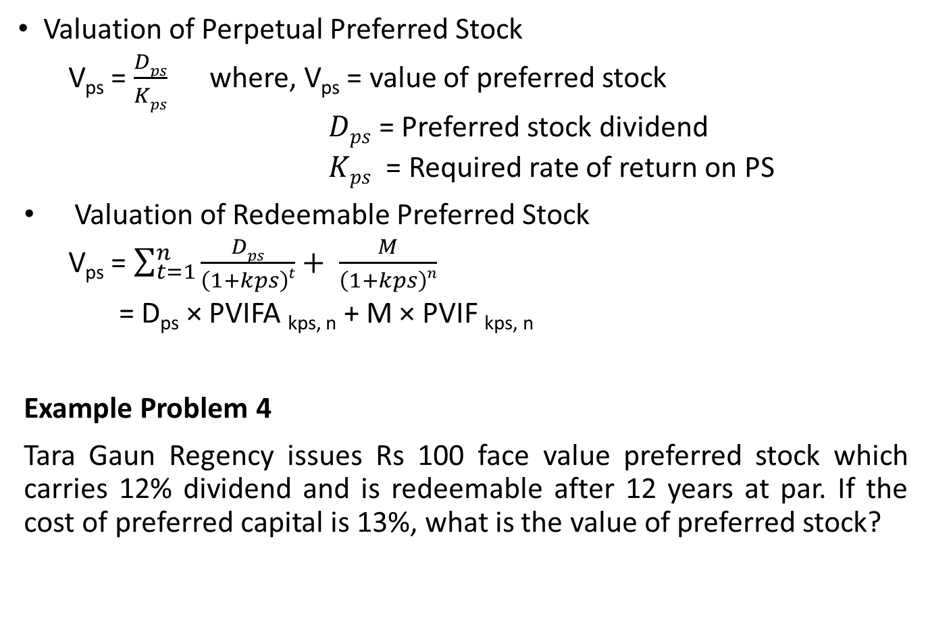
Preferred Sock Valuation
Valuation of Perpetual Preferred Stock
V_{ps} = $\frac{Dps}{Kps}$ where, V_{ps} = value of preferred stock
$Dps$ = Preferred stock dividend
$Kps$ = Required rate of return on PS
Valuation of Redeemable Preferred Stock
V_{ps} = $\sum_{t=1}^{n}{\frac{Dps}{\left(1+kps\right)t}}+ \frac{M}{\left(1+kps\right)n}$
= D_{ps} × PVIFA _{kps, n} + M × PVIF _{kps, n}
Example Problem 4
Tara Gaun Regency issues Rs 100 face value preferred stock which carries 12% dividend and is redeemable after 12 years at par. If the cost of preferred capital is 13%, what is the value of preferred stock?

